Slide 1

Prescriptive Analysis on Bullying and Adolescent Risk Behavior Prevention
@ Ziyi Song

Slide 2

About this research topic: School bullying has been a critical issue
Content of analysis:
Adolescent risk behaviors after being bullied
Possible reasons of being bullied on school property
Suggestions and recommendations dealing with bullying
Limitations and improvement of the model

Slide 3

Variables of interest
For mean comparison on adolescent risk behaviors
Binary: q23 (being bullied or not)
Carry lethal weapon, chock self or others, attempt suicide, physical fight, smoke cig, smoke weed, play video game, hours of sleep
For regression analysis and classification
Binary: q23 (being bullied or not)
Race, height, bmi, sexual minority, grade, muscle builder, physical activity, being sad, school letter grade

Slide 4
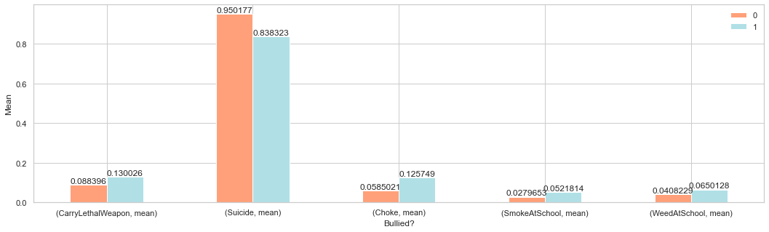
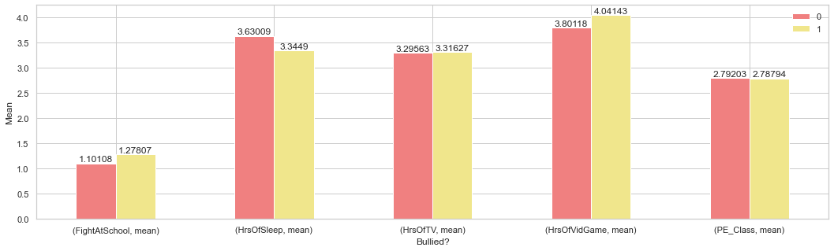
Compare Means

Slide 5
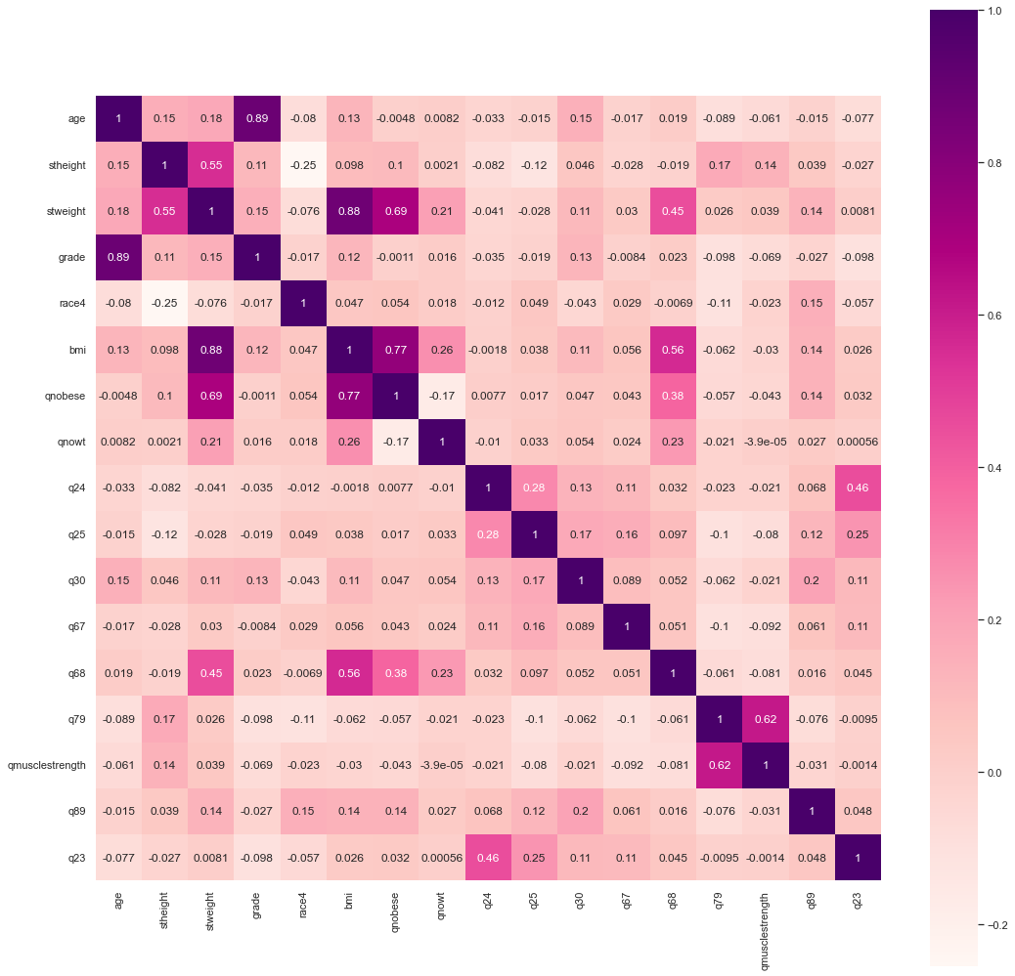
Correlation Matrix

Slide 6
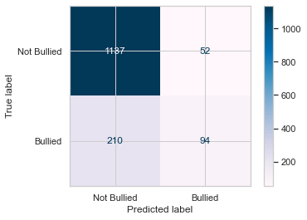
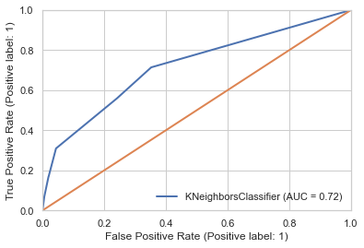
KNN Cross Validation
Partition the original dataset into training (80%) and test (20%) sets.
Feature Selection K=5: grade, being bullied online, sad, smoking, sexual minority
Training Classification accuracy: 0.8329
Test Classification accuracy: 0.8245
ROC = 0.719

Slide 7
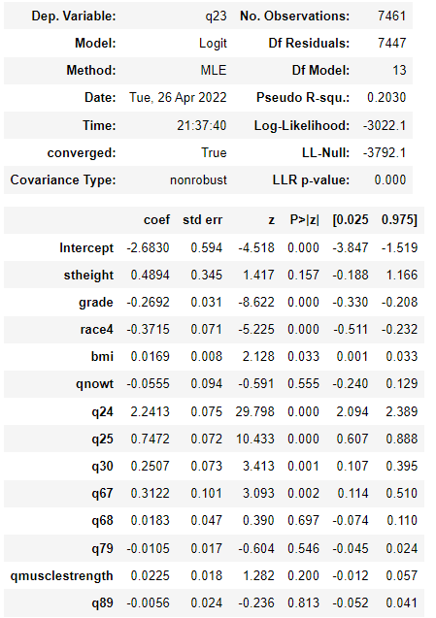
Logistic regression
Pseudo R-square is 0.2, the model works well for such noisy data.
Variable stheight, qnowt, q68(how do you describe your weight), q79(physical activity), qmusclestrength, q89(letter grade earned) are not significant at 0.05 level.
Variable grade(age), race4(minority), bmi, q24(being bullied online), q25(being sad or hopeless), q30(tried Smoking), q67(being sexual minority) are statistical significant at 0.05 level.

Slide 8
Limitations
Data limitation
The data has null values, a selected dataframe cannot contain too many variables or there will be null.
Survey data is usually noisy.
There are questions that are highly correlated, such as bmi and obesity.
Some questions have inconsistent levels that are impossible to recode or use in deeper analysis.
Level answers are mostly discrete.
Model limitation
Hypothesis testing should be conducted when comparing means.
Causations and effects sometimes are ambiguous.
This type of survey data is unsuitable for regression models.

Slide 9
Conclusion and recommendations
Findings
Physical power imbalance could be the primary reason of a student being bullied.
Students that experienced bullies are more likely to carry lethal weapons.
Students that experienced bullies usually have their own way to relief that stress
Racial and sexual minorities face discriminations and bullies at school.
Recommendations
Adults should respond quickly and consistently to bullying behavior.
Parents, school staff can help kids prevent bullying by talking about it.
Bully prevention strategies should be established.
See something, say something.

